Slide 1
Typing Partner

Slide 2

AI Trained By You For You
Write this….

Slide 3
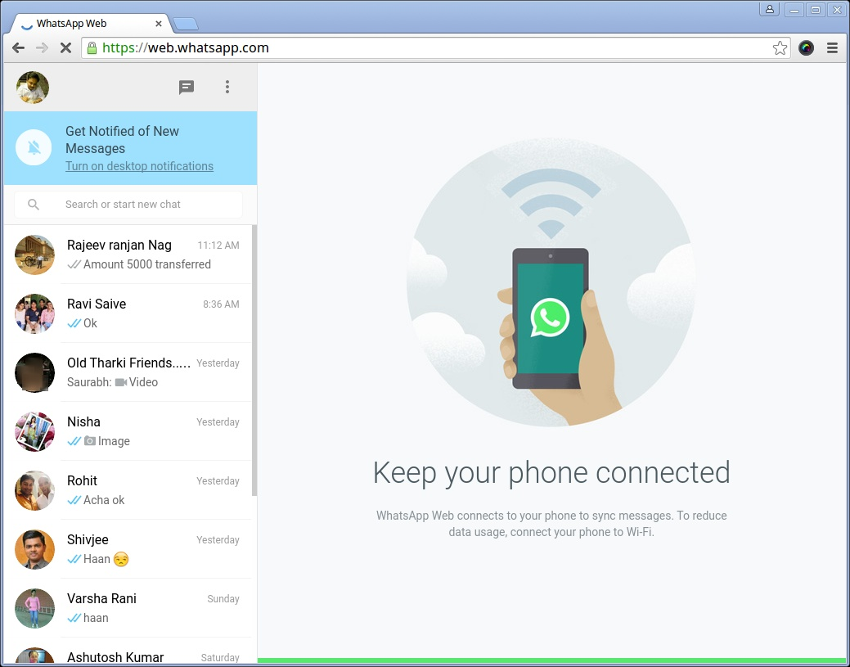
Extension that integrates with Your Browser To Help You Write More in Less Time By Giving You Suggestions According To Your Own Writing Style
This Photo by Unknown Author is licensed under CC BY-NC

